Slide 1

Designing Election Dashboards for Trust

Slide 2


Agenda
Background and Problem
Design and Study Execution
Findings and Insights
© 2026 Adobe. All Rights Reserved. Adobe Confidential.

Slide 3
Background and Problem

Slide 4
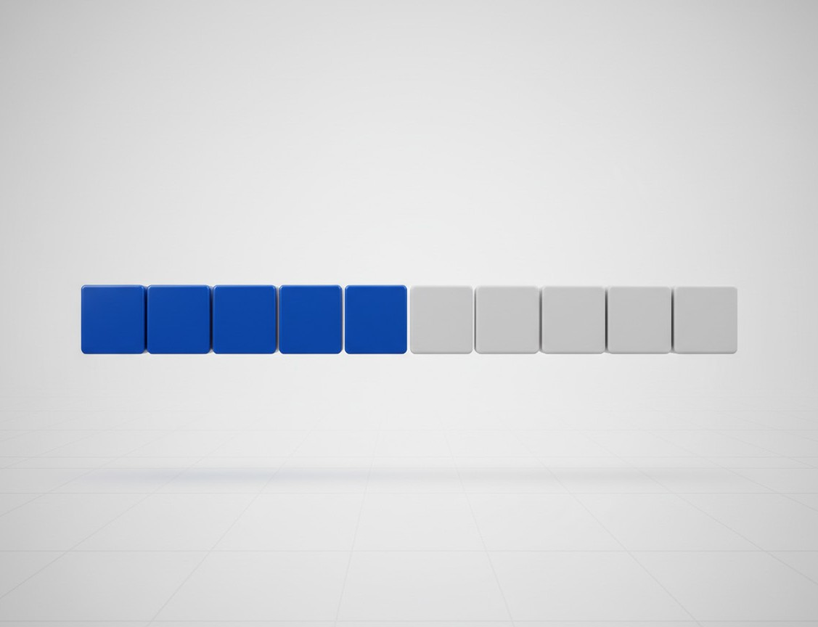
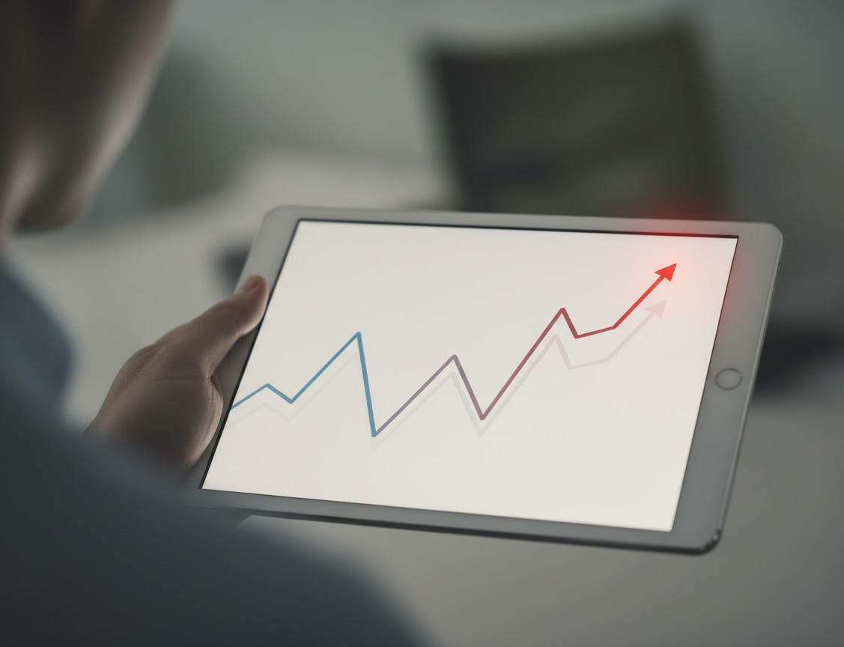
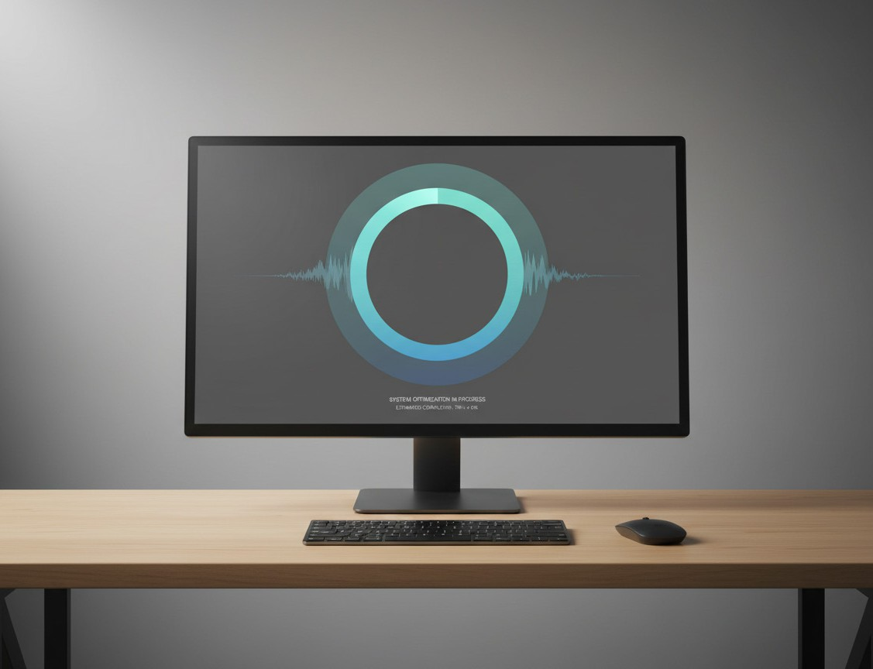
Why This Study Matters
Live results are inherently incomplete
U.S. vote totals update in batches as jurisdictions report over time.
Early leads can be misleading because many ballots remain uncounted.
Partial counts invite misreadings
Visible shifts in trends can look suspicious without process context.
In 2020, some late shifts were wrongly framed as fraud signals.
What this research tests
Can a dashboard that emphasizes progress and uncertainty improve trust?
© 2026 Adobe. All Rights Reserved. Adobe Confidential.

Slide 5
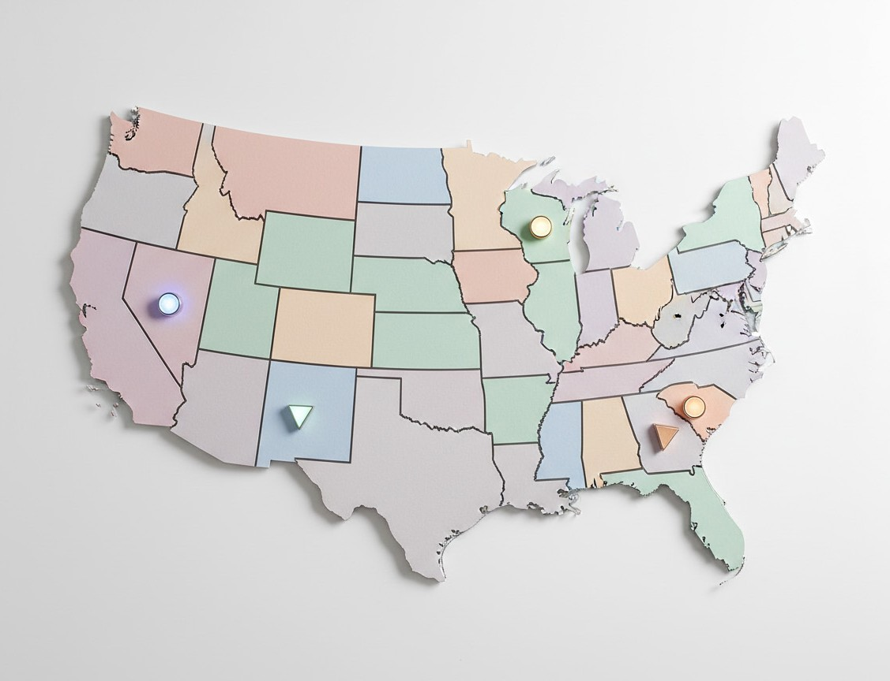

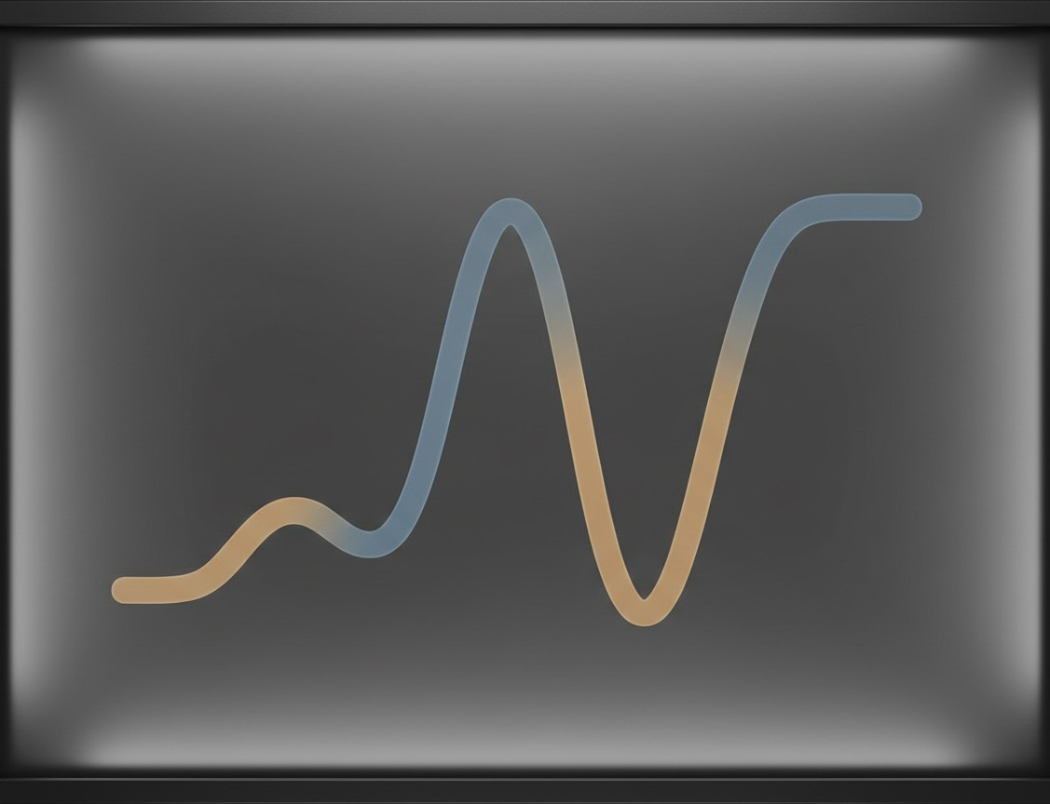
The U.S. Context
Decentralized administration
Elections are run by local jurisdictions, not a national oﬃce.
Rules differ across states, so results arrive at different speeds.
How results reach the public
Newsrooms do not count votes; they publish reported tallies.
Organizations like The Associated Press aggregate local reports.
Why patterns can look odd
As vote batches arrive, leads can shift without wrongdoing.
Election-night numbers are unofficial until certification.
© 2026 Adobe. All Rights Reserved. Adobe Confidential.

Slide 6
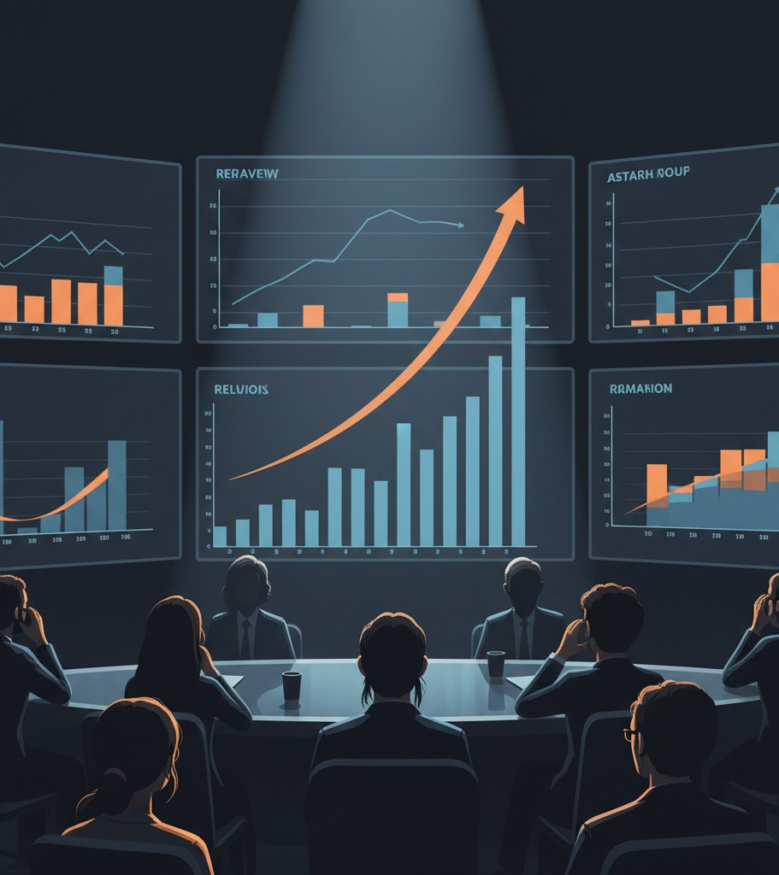
What Problem They Addressed
Misread patterns in live counts
In 2020, late shifts in some states were cited as “fraud.”
But reporting delays and ballot processing can create real swings.
Partial data feels final
Viewers often treat early totals as stable trends.
That encourages overconfidence and suspicion when numbers change.
Design question
Can dashboards set better expectations as results arrive over time?
© 2026 Adobe. All Rights Reserved. Adobe Confidential.

Slide 7
Design and Study Execution

Slide 8
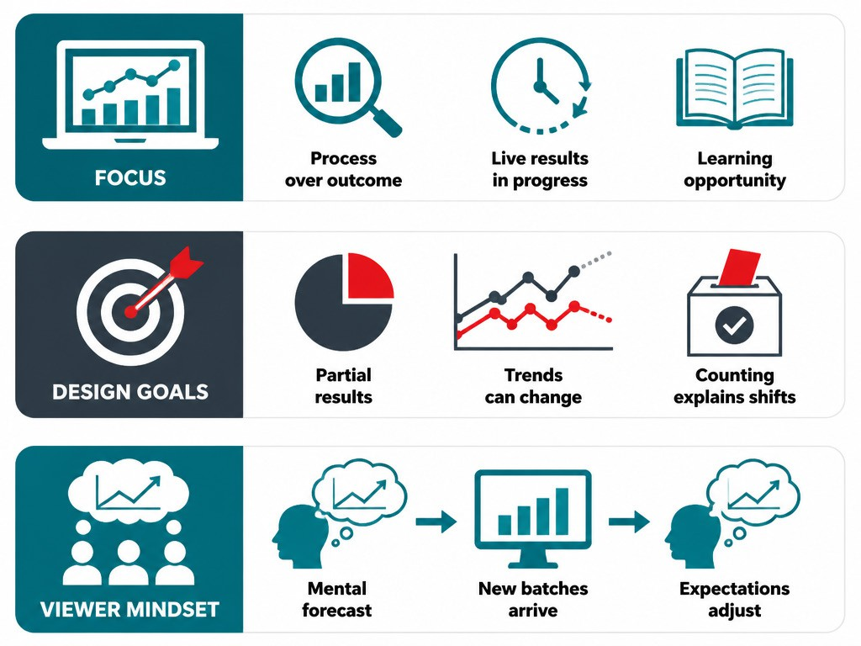
The Design Strategy
Teach the process, not the race
The dashboard focused on how counts evolve, not only who leads.
It treated live results as an unfolding process audiences can learn.
Three design goals
Make it clear that reported votes are still partial.
Show that apparent trends can shift as more votes arrive.
Link visible shifts to counting procedures, not assumed wrongdoing.
How viewers form expectations
Assumed viewers enter with a “mental forecast” of the outcome.
As new batches report, viewers revise expectations over the night.
© 2026 Adobe. All Rights Reserved. Adobe Confidential.

Slide 9
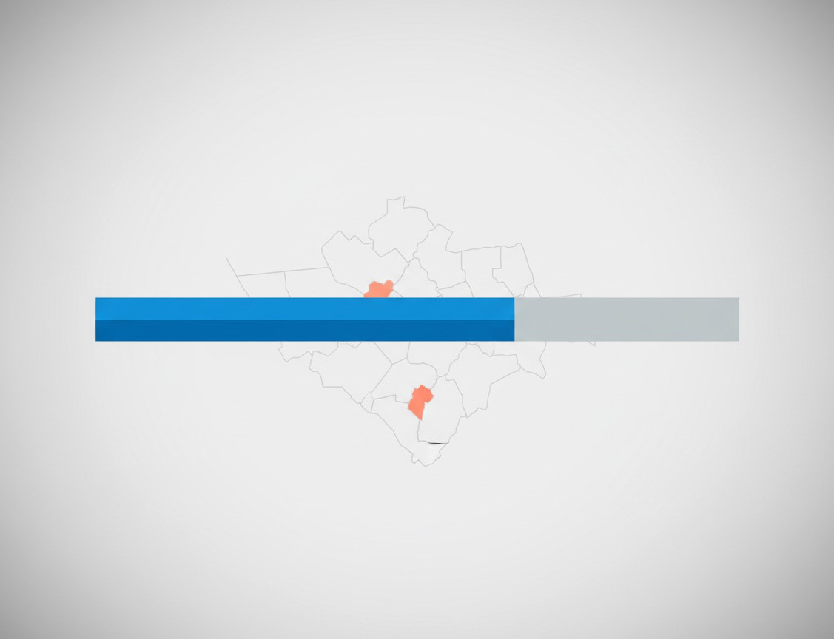
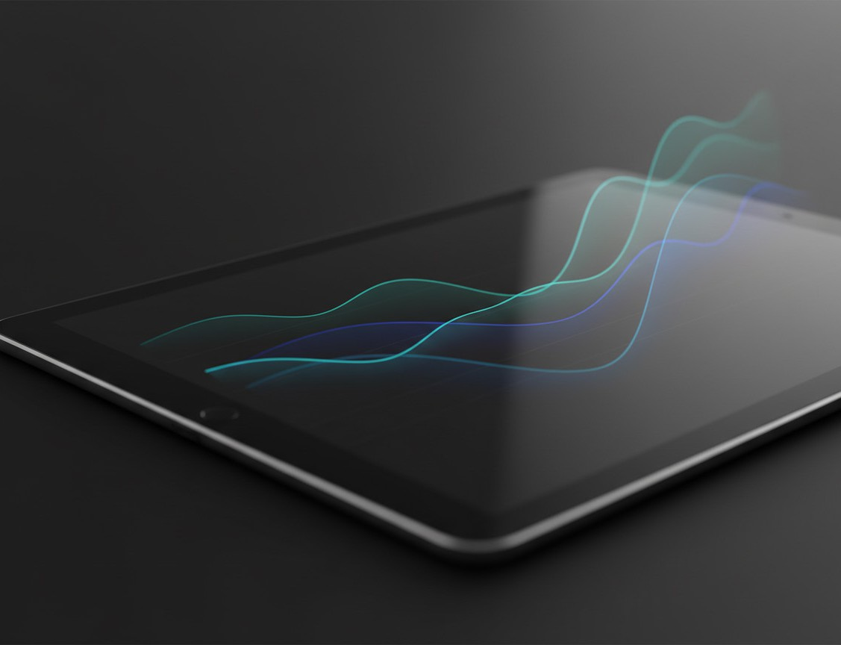
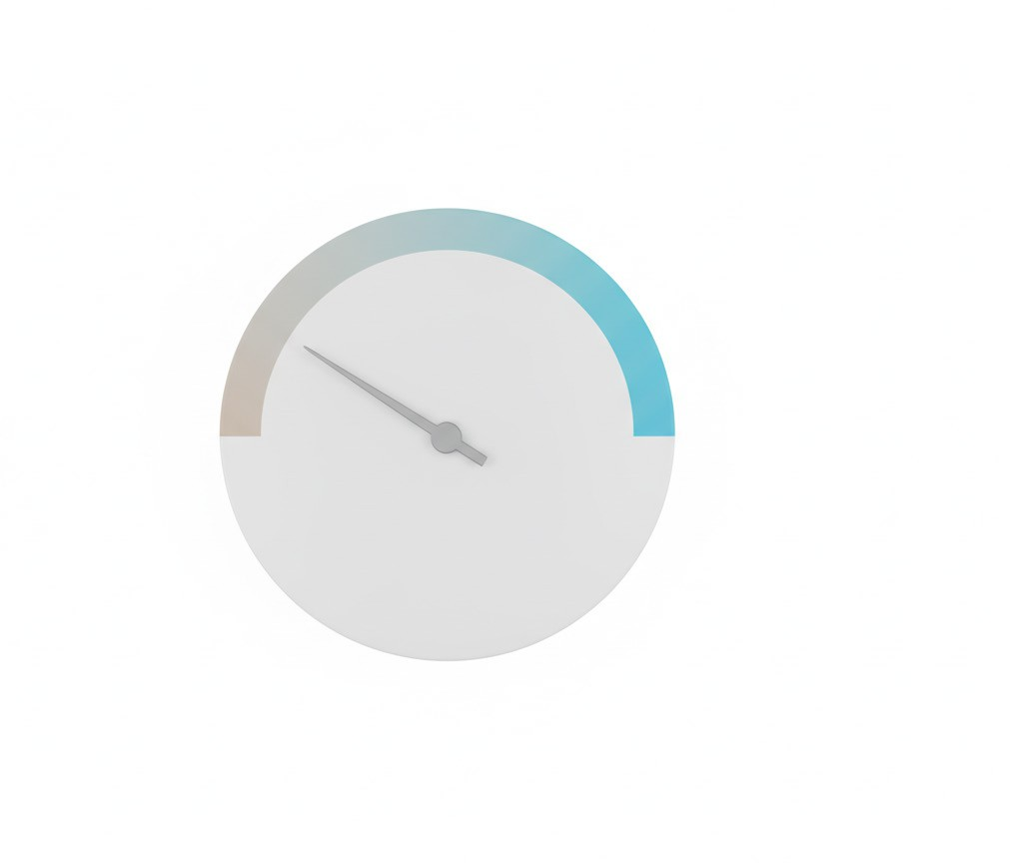
What the Dashboard Added
Make partial results obvious
A large progress bar emphasized votes counted versus votes outstanding.
County maps also showed remaining votes, not just who leads.
Show what could happen next
Live forecasts previewed possible paths for vote share over time.
A second forecast showed expected pace of counting for days.
Explain shifts without drama
Short text linked flips and surges to counting procedures.
The goal was to reduce fraud assumptions from normal patterns.
© 2026 Adobe. All Rights Reserved. Adobe Confidential.

Slide 10
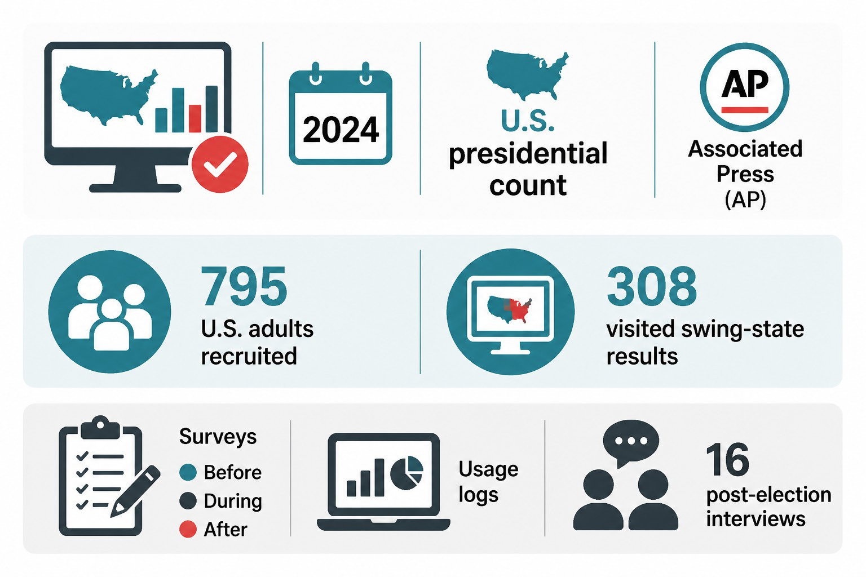
How the Study Ran
Real-election deployment
The dashboard ran live during the 2024 U.S. presidential count.
It used real-time results from the Associated Press (AP).
Participants and engagement
795 U.S. adults were recruited and assigned a dashboard version.
308 visited at least one swing-state results page.
Mixed-method evaluation
Surveys were collected before, during, and after election night.
Usage logs plus 16 post-election interviews captured lived experience.
© 2026 Adobe. All Rights Reserved. Adobe Confidential.

Slide 11
Findings and Insights

Slide 12
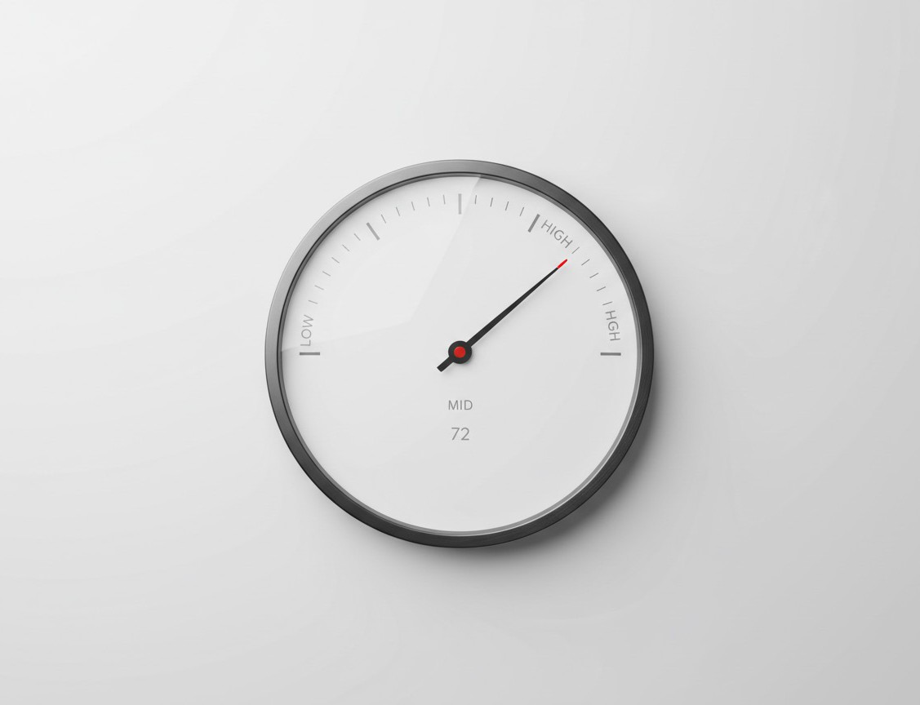
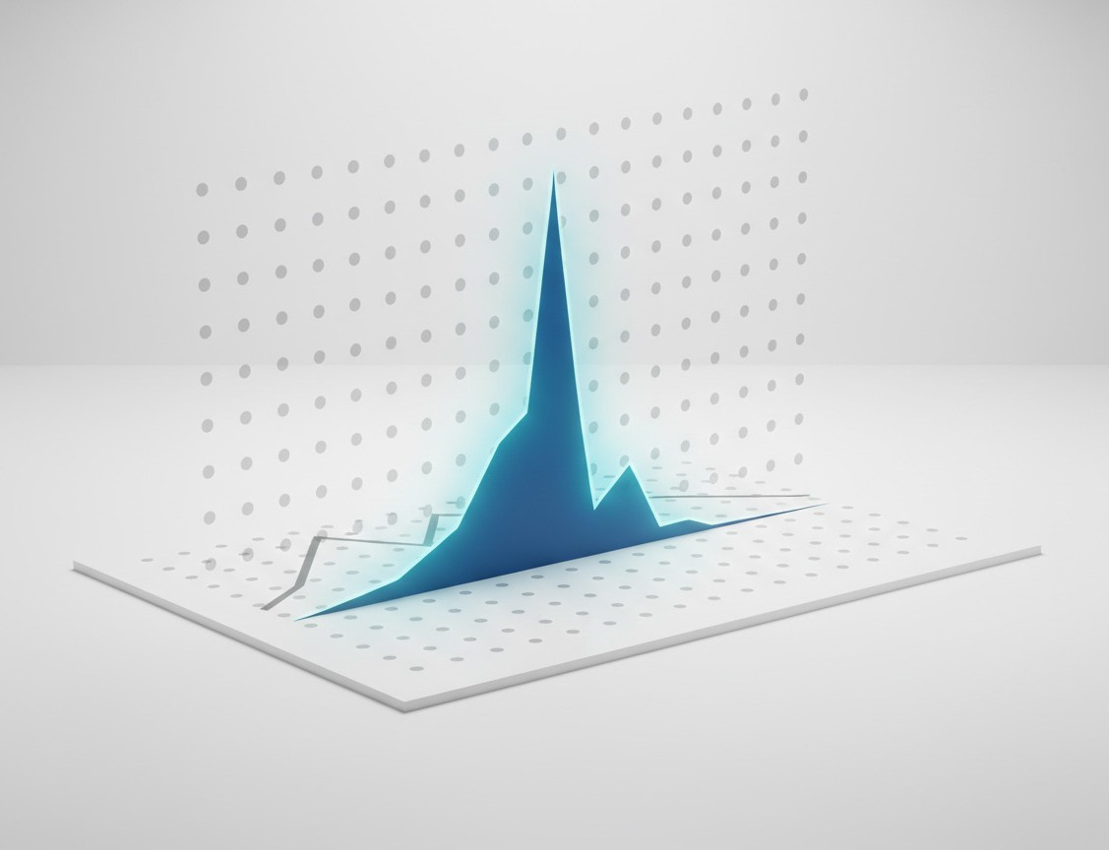

What Surveys Suggest
Confidence in counting
Seeing live forecasts was linked to a small rise in confidence.
The size of the change was modest, not a dramatic shift.
Fraud perceptions
Forecasts were linked to slightly lower agreement that “spikes” imply fraud.
This matters because partial counts can look suspicious without context.
Role of explanations
Short text explanations alone showed no clear measurable survey effect.
© 2026 Adobe. All Rights Reserved. Adobe Confidential.

Slide 13

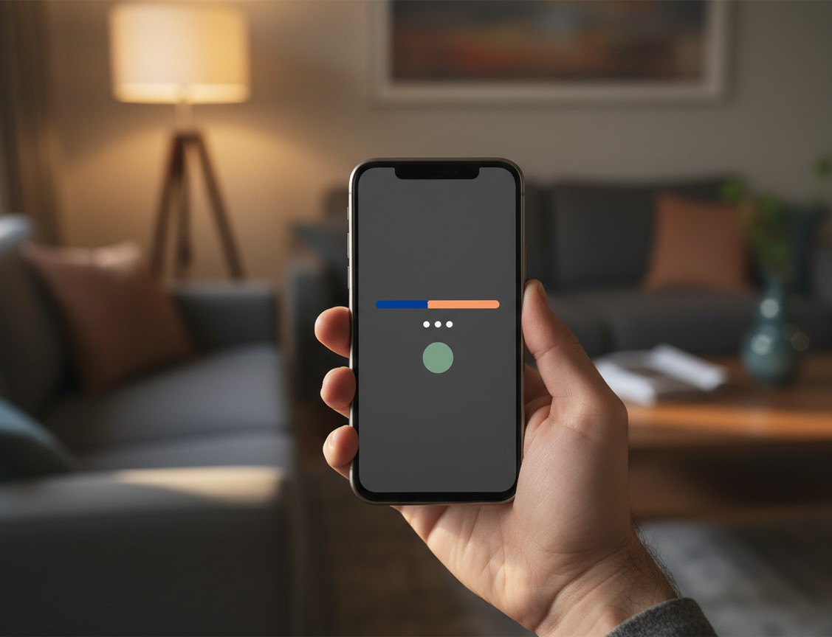
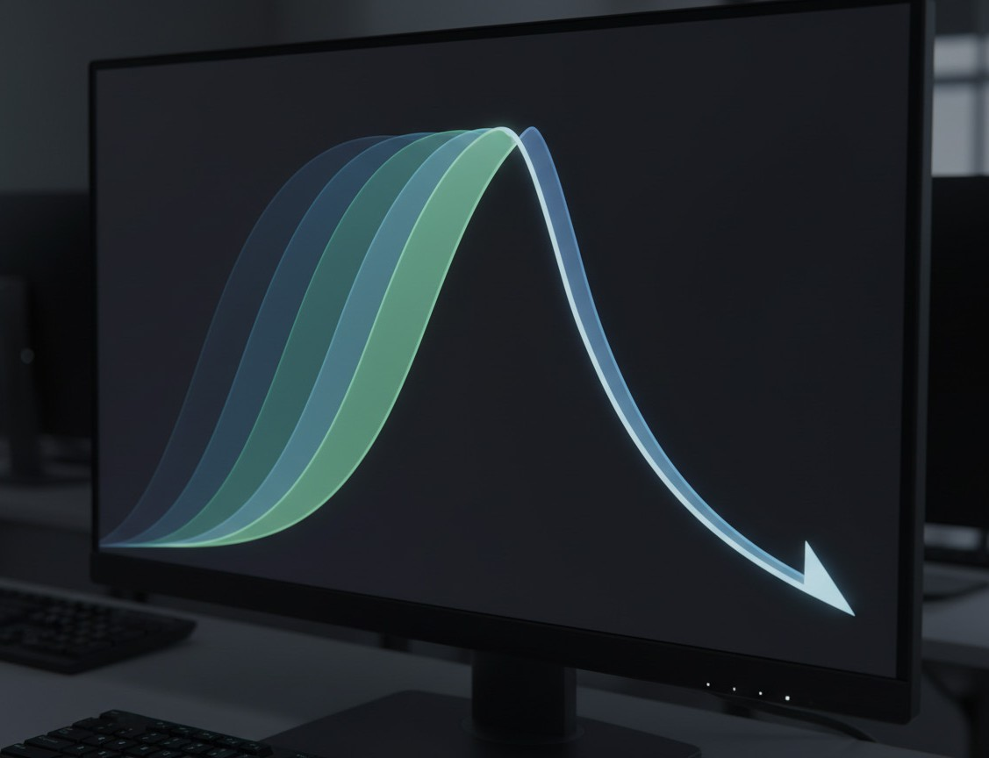
What Interviews Revealed
A calm place to check results
Participants treated it as a neutral, numbers-first reference point.
They used it to confirm what they were hearing elsewhere.
Agency over “media hype”
People liked checking updates on their own schedule.
The minimalist display felt less dramatic than TV coverage.
Forecasts: trusted, not always useful
Many found early forecasts too wide to guide expectations.
Later, forecasts often matched what seemed already obvious.
© 2026 Adobe. All Rights Reserved. Adobe Confidential.

Slide 14
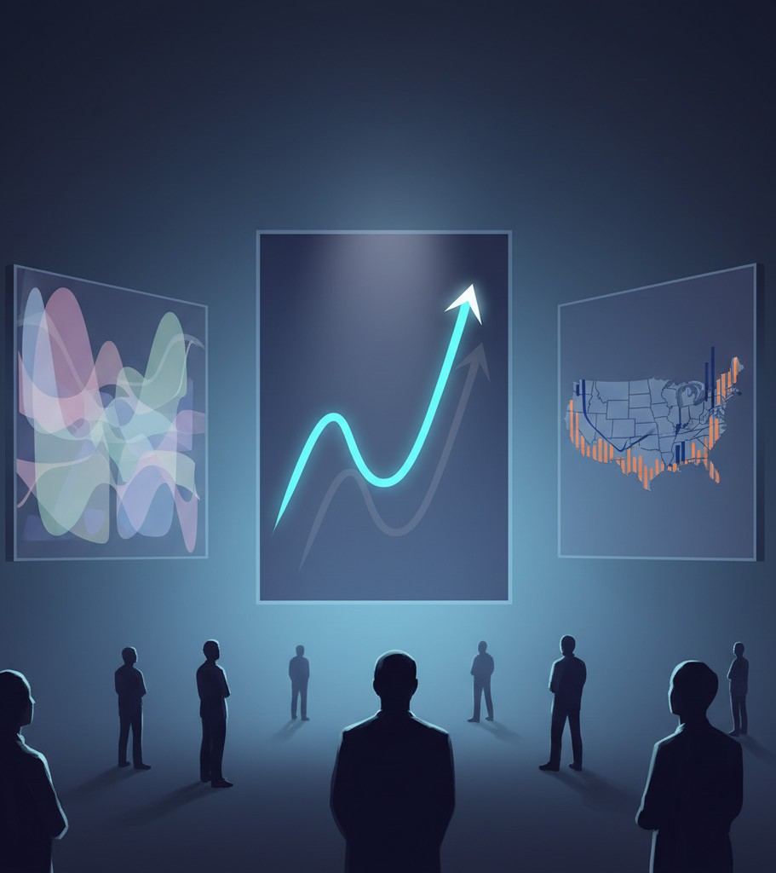
Why Forecasts Are Tricky
Uncertainty can feel unhelpful
Early forecasts were often very wide, signaling “we still don’t know.”
Some viewers understood that message, but found it unsatisfying.
Certainty can feel unnecessary
Later, forecasts sometimes matched what vote totals already suggested.
Once the likely winner felt obvious, forecasts added little new value.
A design balancing act
Forecasts seemed most “useful” when they gave a clear signal.
But “trustworthy” forecasts often aligned with observed trends and media.
© 2026 Adobe. All Rights Reserved. Adobe Confidential.

Slide 15
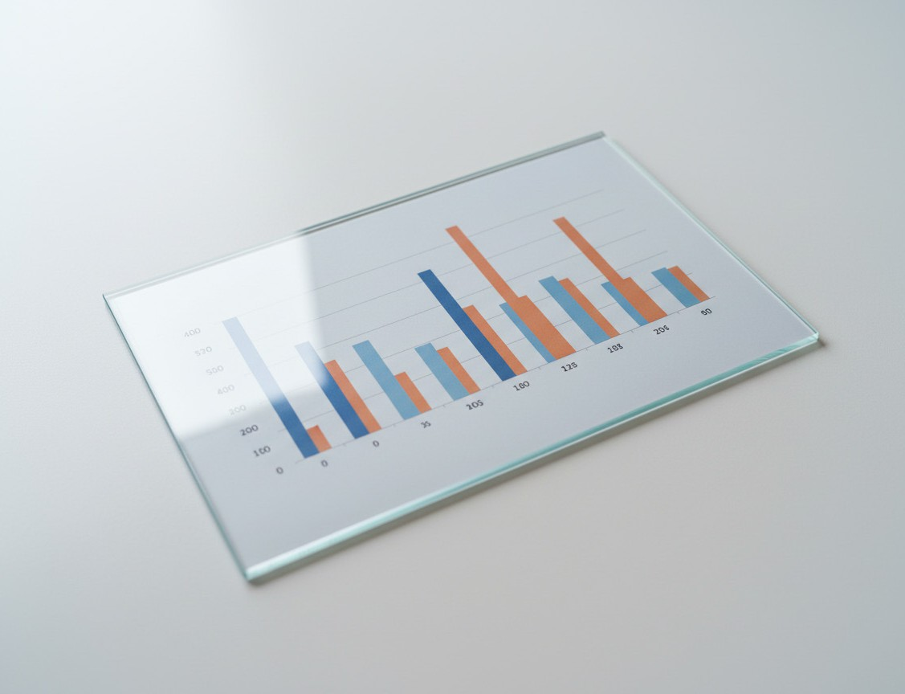
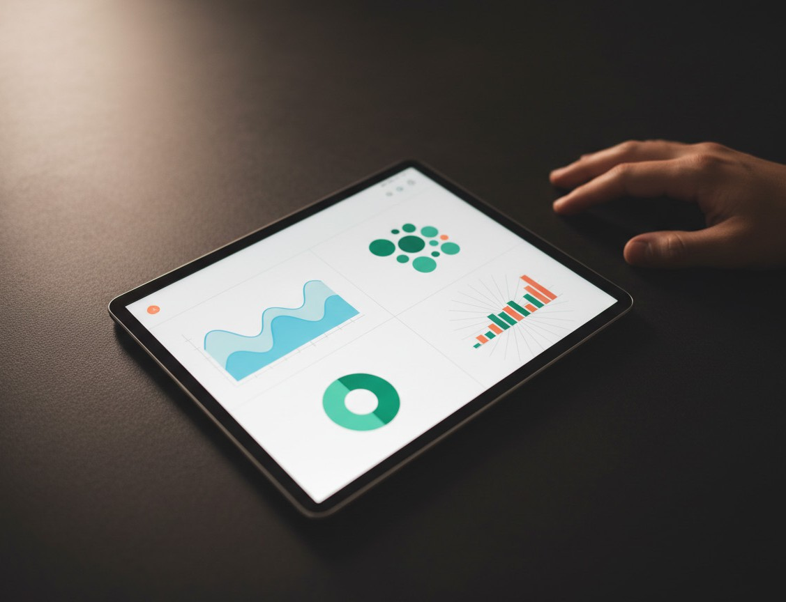
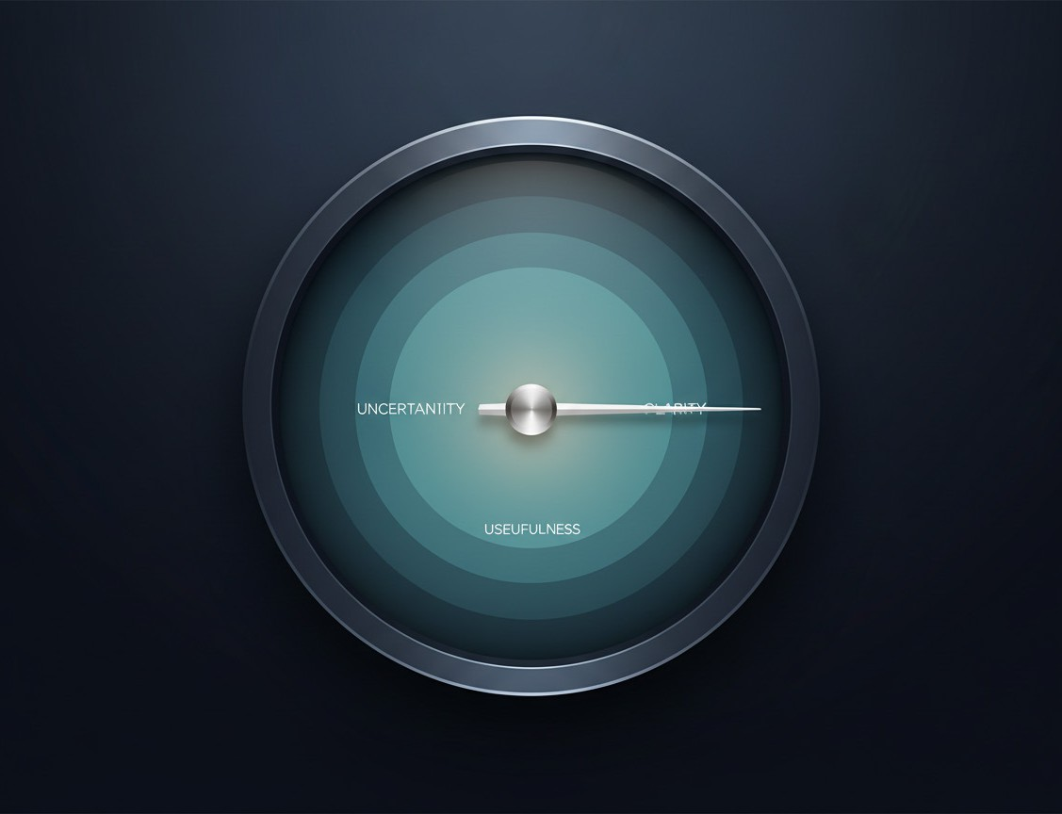
Takeaways Beyond the U.S.
Lead with what is unknown
Make partial data and remaining work visible before drawing conclusions.
Treat early patterns as tentative, and explain why they may shift.
Design for real audiences
Assume viewers bring prior beliefs, emotions, and other media narratives.
Support agency by letting people check results on their own terms.
Trust is more than accuracy
A calm, “just-the-data” tone can reduce perceived hype and bias.
Forecasts must balance uncertainty, clarity, and perceived usefulness.
© 2026 Adobe. All Rights Reserved. Adobe Confidential.

